Slide 1
A long-term commitment to self-financing of large landscape scale conservation
Joanna Elliott
Senior Director, FFI

Slide 2
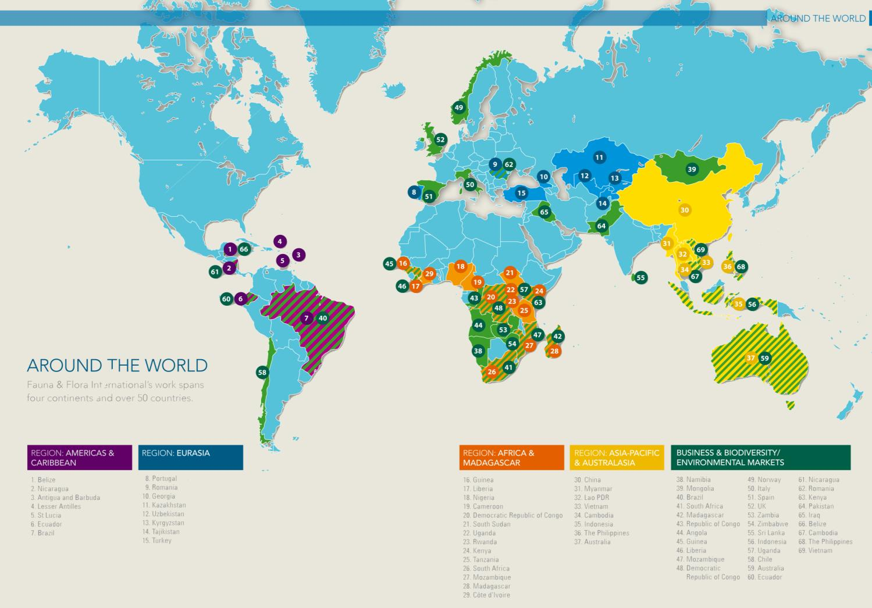
Fauna & Flora International works on over 140 projects in more than 50 countries around the world.

Slide 3
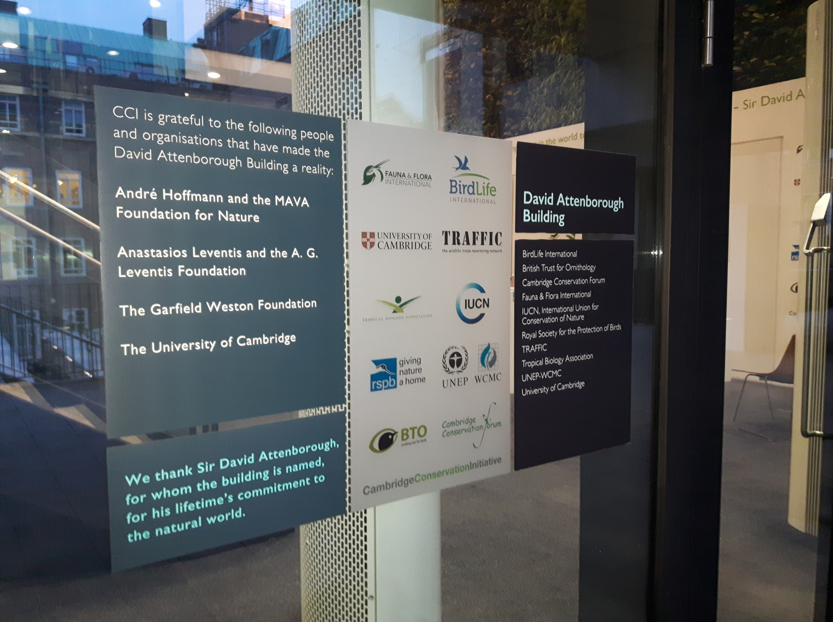

Slide 4
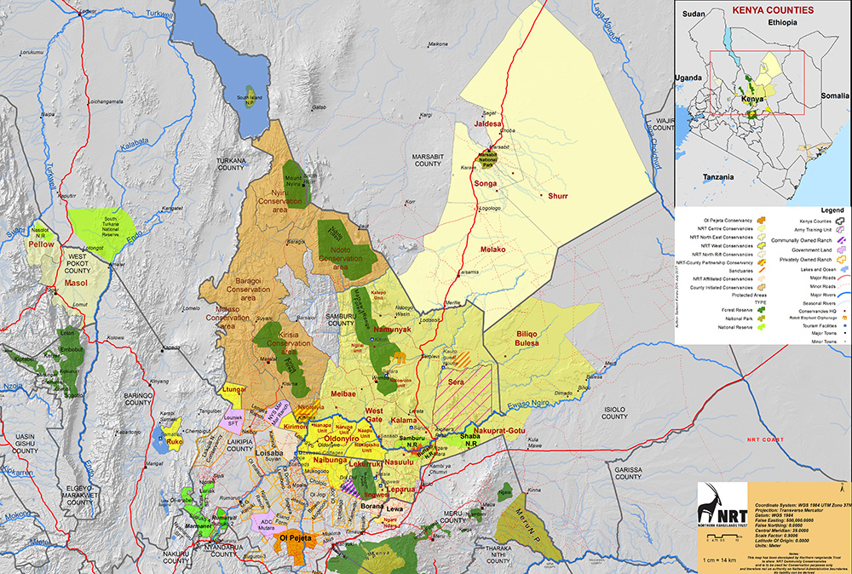
Greater Ewaso / NRT Landscape

Slide 5
Ecosystem Scale Wildlife Movement

Slide 6
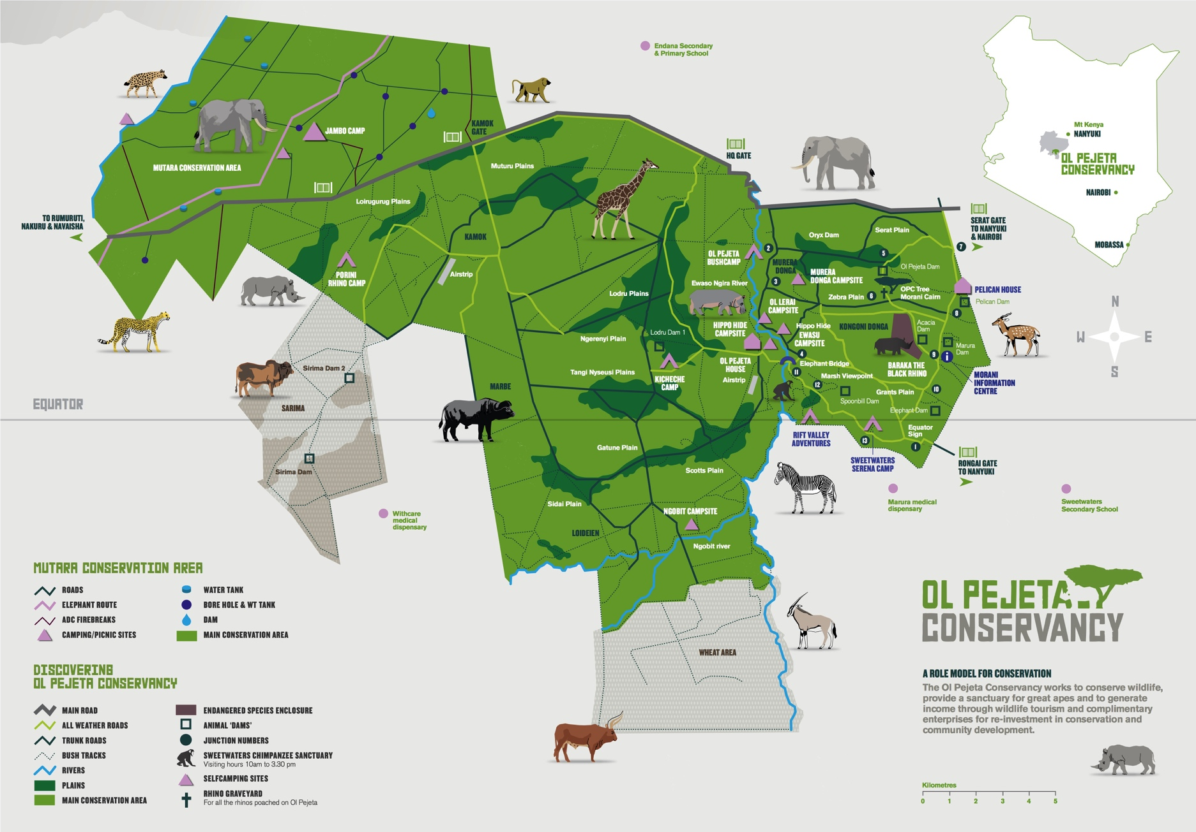

Slide 7
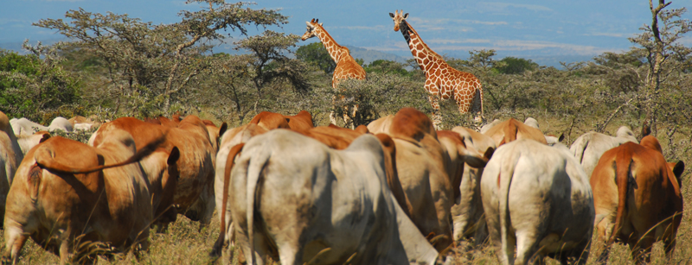
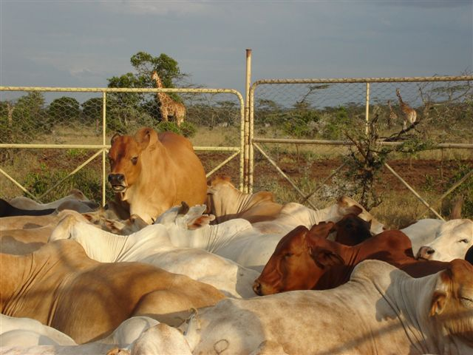
Integrated Land Management System

Slide 8
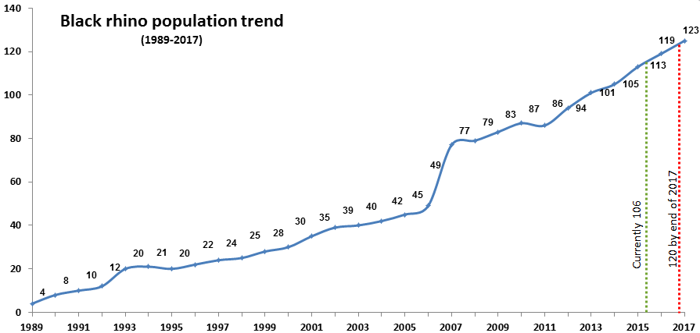
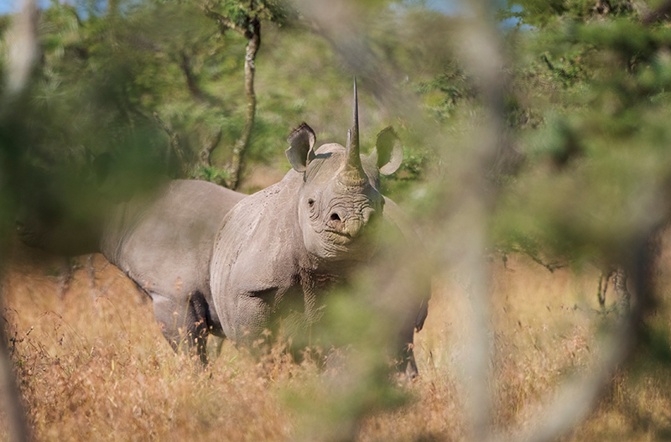
Black Rhino Success

Slide 9
Northern White Rhino

Slide 10
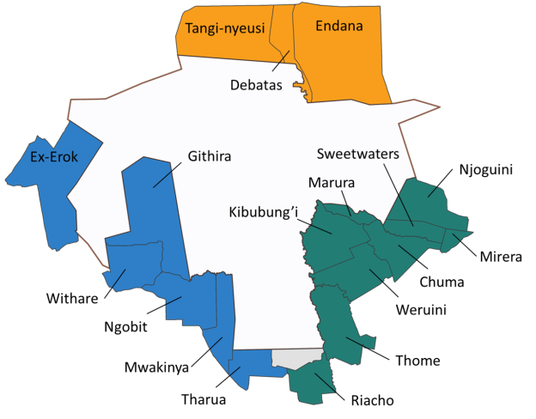
26,000 people
4,800 households
5 water associations
42 schools
215 formal groups
8 dispensaries

Slide 11
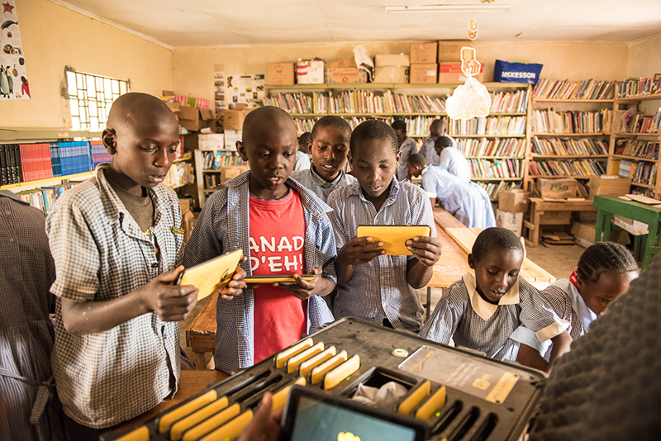
OPC Schools Program

Slide 12
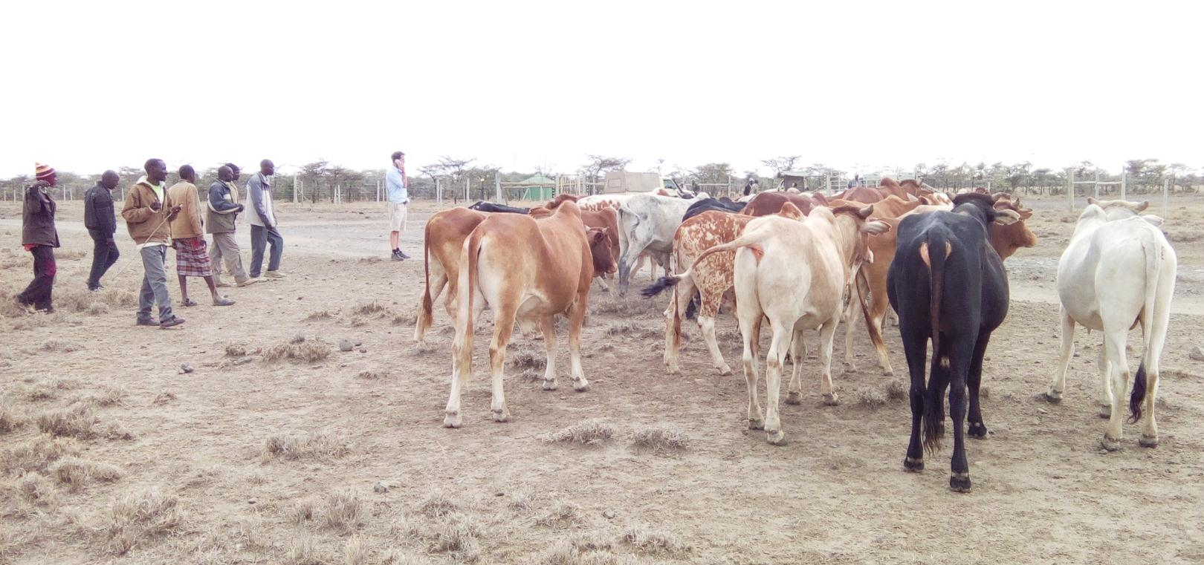
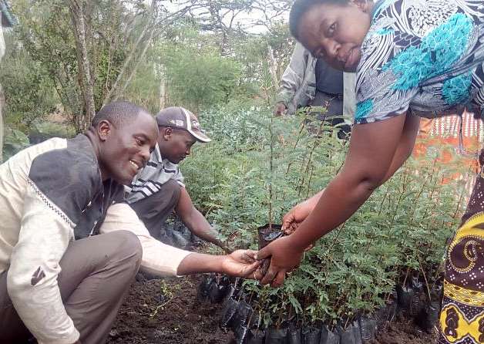
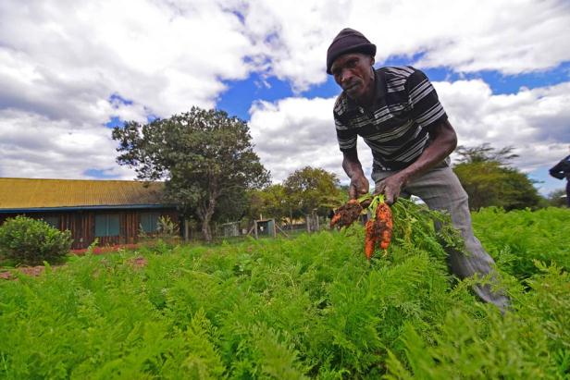
Supporting Agribusiness

Slide 13
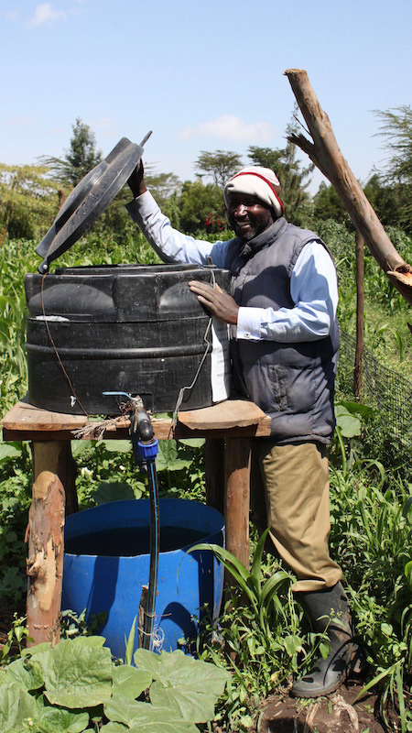
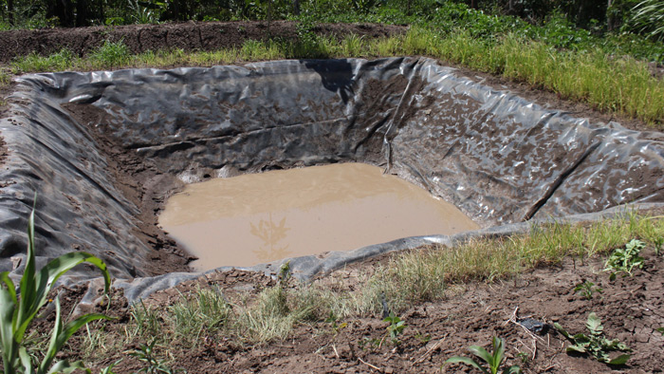
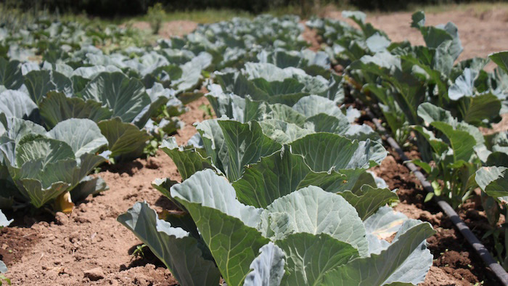
Community Water Projects

Slide 14
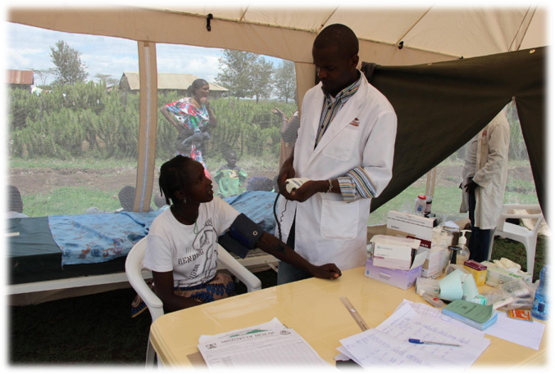
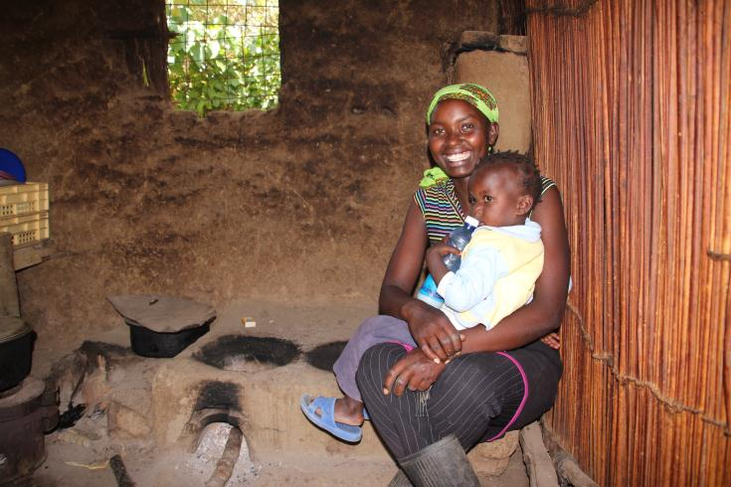
Clinics & Dispensaries
Solar Energy & Improved Cooking Stoves

Slide 15
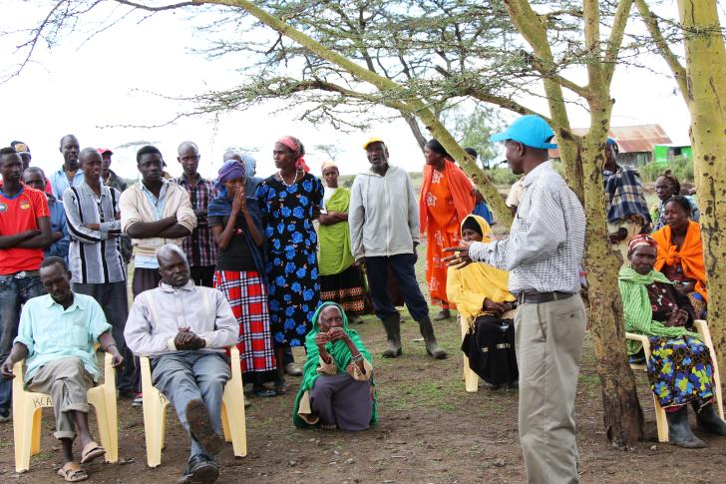
Addressing Human Wildlife Conflict

Slide 16
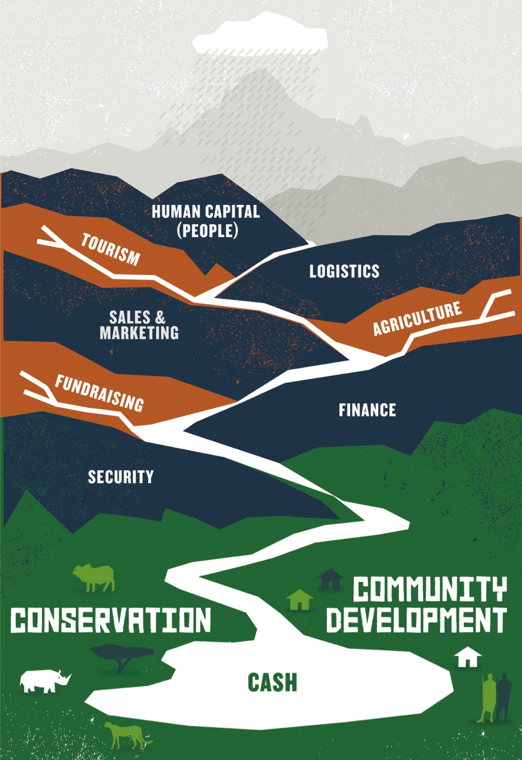
OPC Financial Model

Slide 17
Sources of Income – FY 2016
1%
4%
3%

Slide 18
Huge Cost Of Security For Rhinos
Annual Cost Of Rhino Protection: US$ 1.5m+
Community
Boundary fence
Community assistance
Cattle herders / general security
Rhino patrols
Ol Pejeta armed teams
Aircraft and tracker dogs

Slide 19
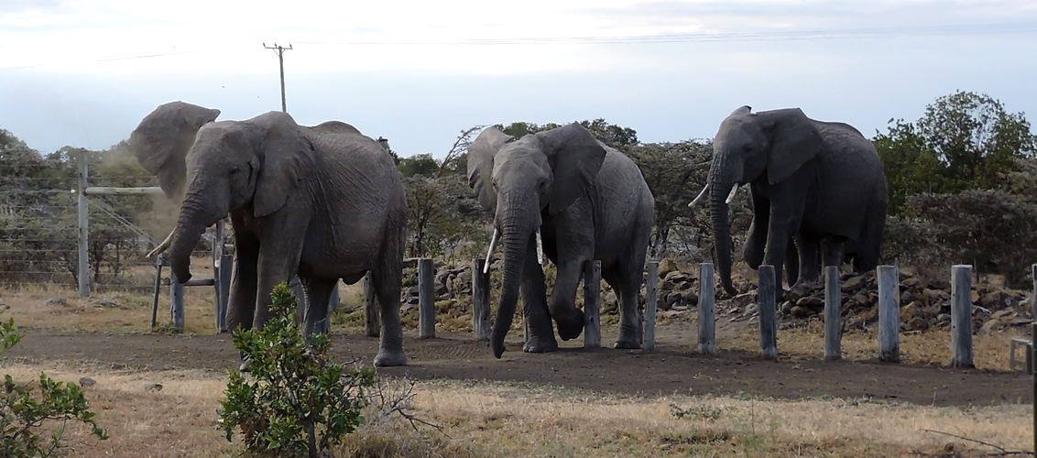
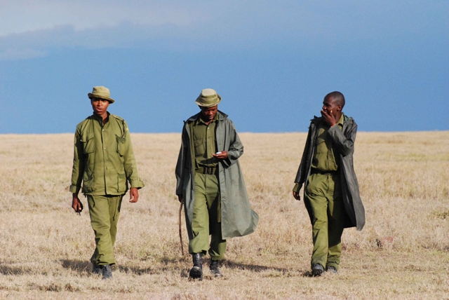
Security Measures

Slide 20
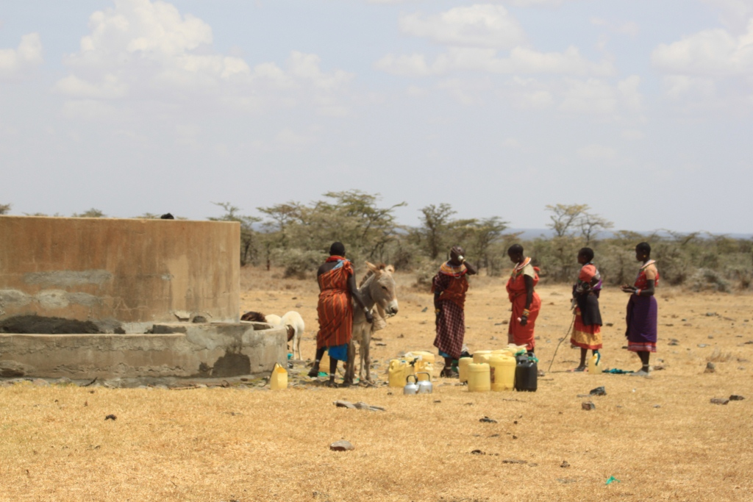
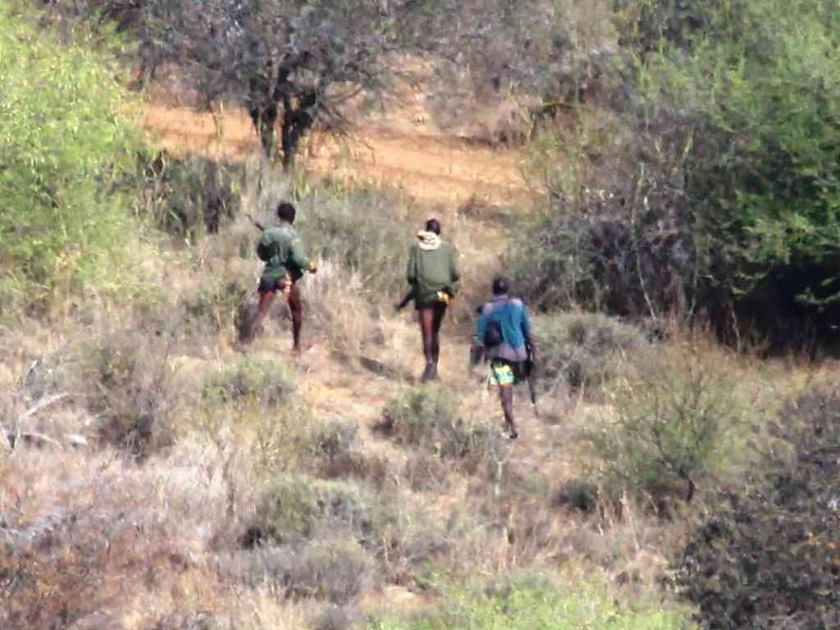
Major Challenges

Slide 21
Future Priorities
Drought mitigation strategies across wider landscape
Strengthen and extend community collaboration & development
Strengthen integration into wider socio-political landscape
Extension of connectivity – black rhino ++

Slide 22
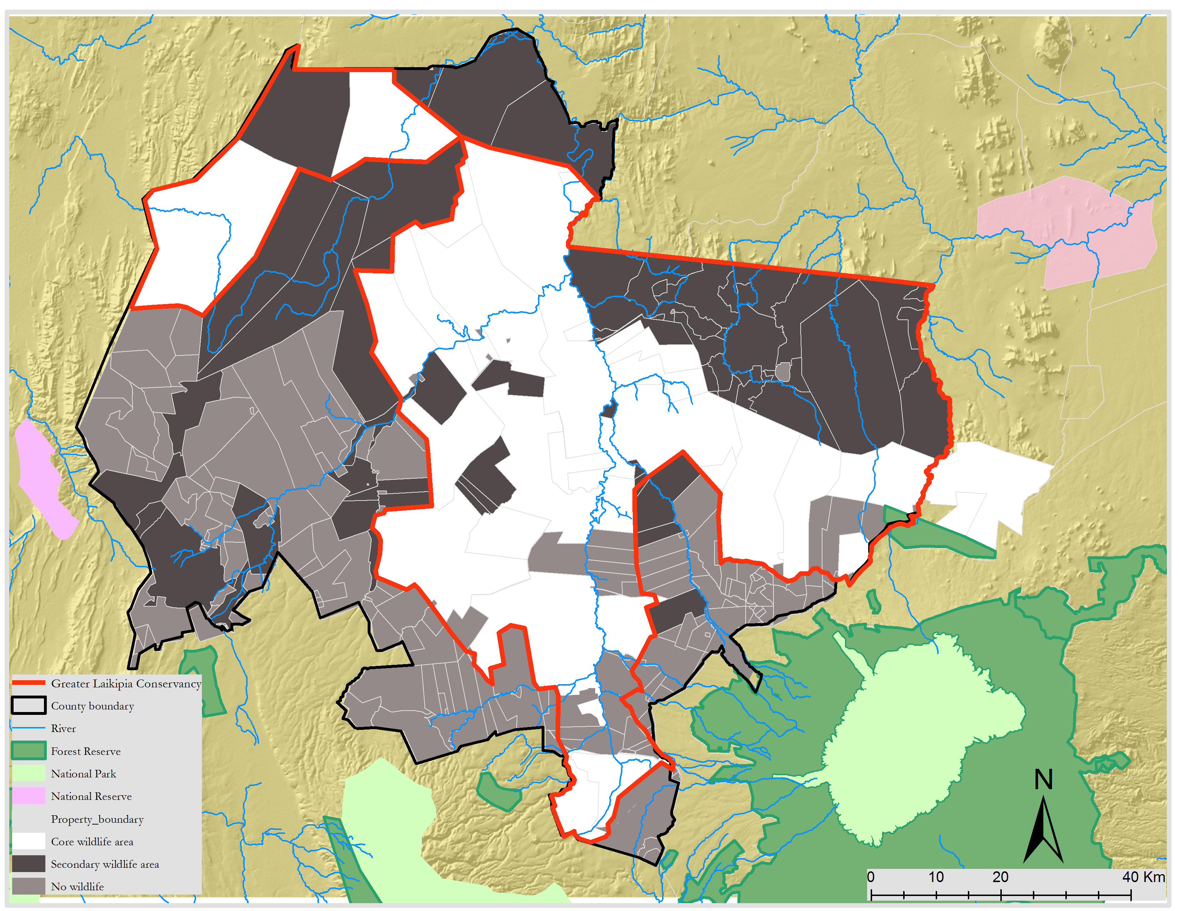
Vision: Wider Laikipia Landscape

Slide 23
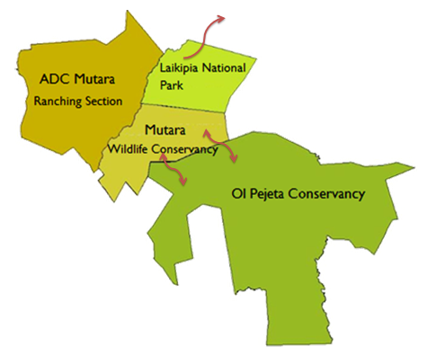
Potential Rhino (And Other Species) Expansion Areas
Black Rhino Popn: 114
Southern White Rhino Popn: 27
Northern White Rhino Popn: 3

Slide 24
Thank you

